Slide 1
Authoring environments for adaptive testing
Thanks to Eduardo Guzmán, Ricardo Conejo and Emilio García-Hervás

Slide 2
Summary
An overview on adaptive testing
SIETTE
  The authoring environment
Conclusions

Slide 3
Testing
The main goal of testing is to measure student knowledge level in one or more concepts.
Computerized Adaptive Testing (CAT) defines which questions are the most adequate to be posed to students, when the tests must finish, and how student knowledge can be inferred during the test.

Slide 4
CAT
CAT comprises the following steps:
  Select the best item according to the current estimation of the student’s knowledge level.
  The item is asked, and the student responds.
  According to the answer, a new estimation of the knowledge level is computed.
  Steps 1 ~ 3 are repeated until the stopping criterion is met.

Slide 5
CAT (cont.)
The advantages of CAT
  The number of items posed is different for each student, and depends on his/her knowledge level.
  Students neither get bored, nor feel stressed.
  It reduces the possibility of cheating.
The disadvantages of CAT
  The construction of CAT is costly.
  The parameters of items must be determined before the test can be applied.

Slide 6
An overview on adaptive testing
It is based on statistical well-founded techniques
Tests are fitted to each student’s needs:
  The idea is to mimic the teacher behavior when assesses orally a student
  Questions (so-called items) posed vary for each student
In general, in these tests, items are posed one by one
In general, the adaptive engine used is based on the Item Response Theory (IRT)

Slide 7
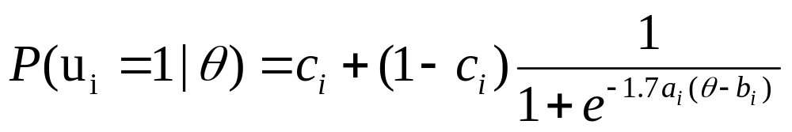
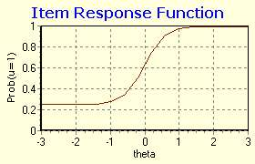
IRT
Item Response Theory (IRT)
a_{i} : item discrimination
b_{i} : item difficulty
c_{i} : guessing factor
a_{i} = 2.0, b_{i} = 0.0, c_{i} = 0.25 Ө = -3.0 to 3.0

Slide 8
Learner Model
Necessary for adaptation
Stereotyped & Run-time model (micro & macro analysis)
Includes:
  demographic data
  learner’s prior knowledge
  learner’s education level and area of expertise
  learner’s demonstrated knowledge level on the topics assessed.
  history of performance

Slide 9
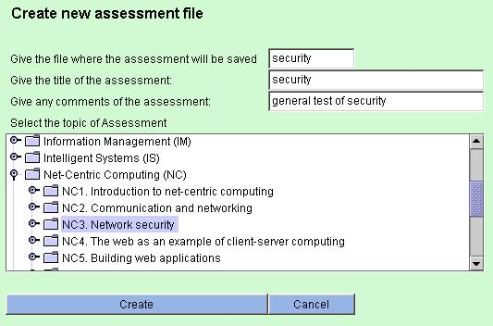
Domain Model
Details about the assessment, also selecting its topic from a given vocabulary (e.g. CS)

Slide 10
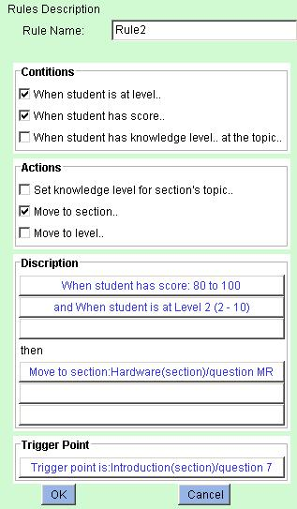
Rule Model
A number of conditions that will be checked at a ‘trigger point’ (which s/he also defines) and the action that will be taken if they are satisfied.

Slide 11
Assessment Tools
Some of the well-known commercial authoring tools include:
    Unit-Exam
    Questionmark Perception
    CourseBuilder
    JavaScript QuizMaker
    Quiz Rocket
    Test Generator Pro
None of the above tools supports adaptation.
Systems that support adaptation include:
    InterBook
    SIETTE
    AHA!
    NetCoach
    ActiveMath
However, apart from SIETTE, none of the above systems offers assessment authoring.

Slide 12
SIETTE
SIETTE is a web-based system for adaptive test generation.
In SIETTE
  Students can take tests, where item correction is shown after each item, with some feedbacks.
  Teachers can construct and modify the test contents and analyzing student performances.

Slide 13
SIETTE: http://www.lcc.uma.es/SIETTE
It is a web-based assessment system through adaptive testing
It has two main modules:
  A student workspace: it comprises all the tools that make possible students take adaptive tests
  An authoring environment: where teachers can add and update the contents for assessment

Slide 14
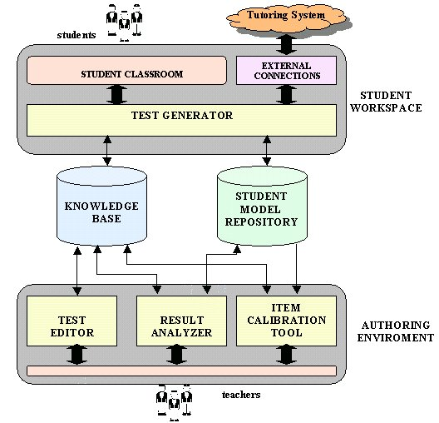
SIETTE: http://www.lcc.uma.es/SIETTE

Slide 15
SIETTE: http://www.lcc.uma.es/SIETTE
where students take tests either for academic grading or for self-assessment

Slide 16
SIETTE: http://www.lcc.uma.es/SIETTE
SIETTE can also work as a cognitive diagnosis module inside web-based tutoring systems

Slide 17
SIETTE: http://www.lcc.uma.es/SIETTE
It is responsible of generating adaptive tests

Slide 18
SIETTE: http://www.lcc.uma.es/SIETTE
It contains items, curriculum structure and test specifications

Slide 19
SIETTE: http://www.lcc.uma.es/SIETTE
It contains data collected while students take tests

Slide 20
SIETTE: http://www.lcc.uma.es/SIETTE
Under development

Slide 21
SIETTE: http://www.lcc.uma.es/SIETTE

Slide 22
Where is the adaptation in SIETTE?
Selection of the topic to be assessed
  Needless to indicate the percentage of items posed from each topic
Selection of the item to pose
Test finalization decision

Slide 23
The authoring environment
TEST EDITOR
Contents are structured in subjects (or courses)
  Each subject is structured in topics, forming a hierarchical curriculum with tree-form
  Items are associated to topics
It manages two teacher stereotypes
  Types:
    Novice: for beginners,
    Expert: for teachers with more advanced mastery on the system and/or in the use of adaptive tests
  The editor appearance is adapted when updating items, topics and tests in terms of the stereotype selected
  Configuration parameters are hidden in novice profile
    They take default values

Slide 24
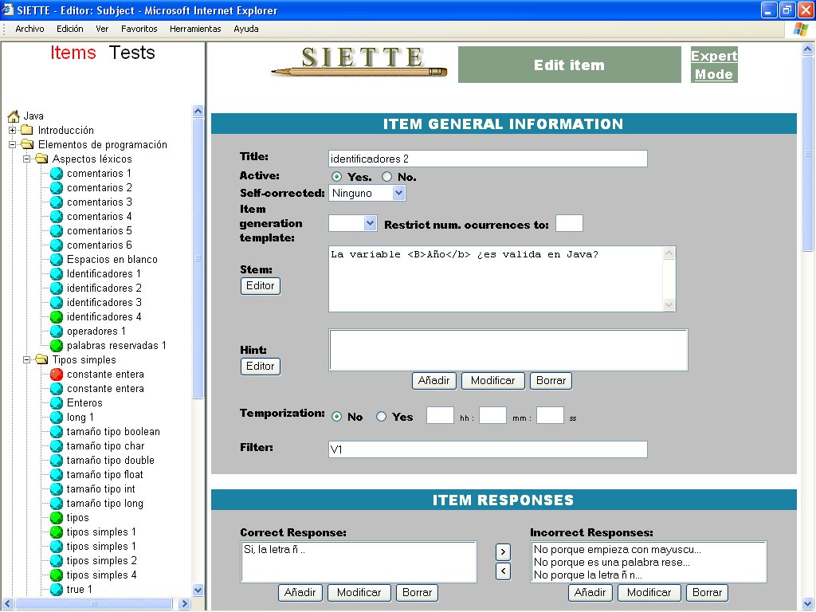
The authoring environment
TEST EDITOR
Subject name

Slide 25
The authoring environment
TEST EDITOR
Curriculum

Slide 26
The authoring environment
TEST EDITOR
Diferent types of item:
true/false
Multiple-choice
Multiple-response
Self-corrected
Generative
.......
Diferent types of item:
true/false
Multiple-choice
Multiple-response
Self-corrected
Generative
.......
Diferent types of item:
true/false
multiple-choice
multiple-response
self-corrected
generative
.......

Slide 27
The authoring environment
TEST EDITOR
Update area:
Its look depends on the element selected on the left frame

Slide 28
The authoring environment
TEST EDITOR
Test definition: questions to be taken into account
  What to test?
    Topics involved in assessment
    Assessment granularity, i.e. number of knowledge levels
  Whom to test?
    This is the student represented by his student model
  How to test?
    Item selection criterion
    Assessment technique
  When to finish the test?
    Finalization criterion
All of them are decided by the teacher during test specification

Slide 29
The authoring environment
TEST EDITOR
Item selection criteria:
  Bayesian: selects the item which minimized the expected variance of the posterior student’s knowledge probability distribution
  Difficulty-based: selects the item with the closest difficulty to the student’s estimated knowledge level
  Both criteria give similar performance and converge when the number of question increases.

Slide 30
The authoring environment
TEST EDITOR
Test finalization criteria:
  Based on accuracy: test finishes when the student’s knowledge probability distribution variance is lesser than certain threshold (it tends to 0)
  Based on confidence factor: test finishes when the probability value in the student’s knowledge level is greater than certain threshold (it tends to 1)
  Both criteria are computed on the estimated knowledge probability distribution

Slide 31
The authoring environment
TEST EDITOR
Student’s knowledge level estimation:
  Maximum likelihood: the knowledge level is computed as the mode of the student’s knowledge probability distribution
  Bayesian: the knowledge level is computed as the mean of the student’s knowledge probability distribution

Slide 32
The authoring environment
RESULT ANALYZER
It is useful for teachers to study the items and the students’ performances
It uses the information stored in the student model repository
It comprises two tools:
  A student performance facility:
    It shows the list of students that have taken certain test
    For each student, it provides: name, test session duration, test beginning date, total number of item posed, items correctly answered, final estimated knowledge level, …
  An item statistic facility:
    It shows statistics about certain item: percentages of student having selected each answer in terms of their final estimated knowledge level
    Very useful for calibration purposes
      devised as a complementary tool for the item calibration tool

Slide 33
Conclusions
Adaptive Web-based Assessment Systems is a “hot” R&D area.
SIETTE is a web-based adaptive assessment system where tests can be suited to students
  The number of items posed is lesser than in conventional testing mechanisms, (for the same accuracy)
  Student’s knowledge level estimation is more accurate than in conventional testing (for the same number of item posed)
  The item exposition is automatically controlled. (difficult items are not presented if easier are not answered correctly)
SIETTE’s authoring environment has adaptable features depending on:
  Two teachers profiles: novice and expert
Need for other tools like SIETTE with emphasis on assessment

